Slide 1

OpenAI API
Your First
Chat
Completion

Slide 2
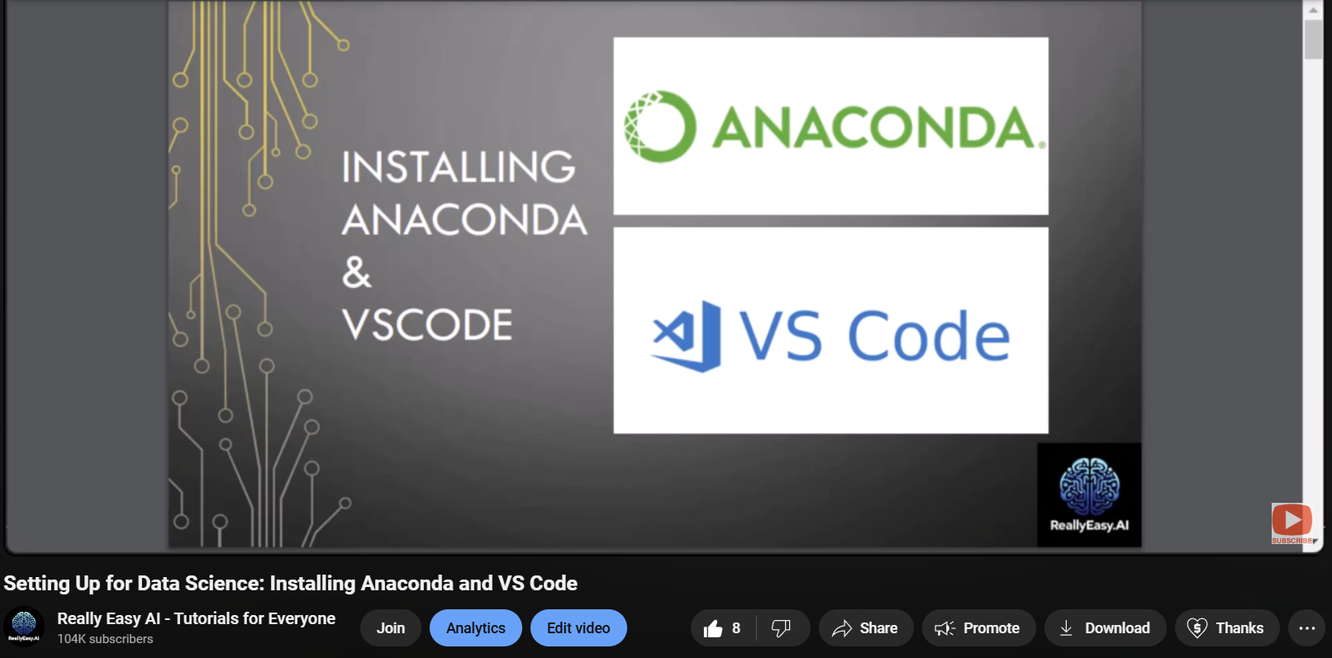
Notes:
https://www.youtube.com/watch?v=50TM9pfYv5U

Slide 3
Documentation & Help Overview

Slide 4
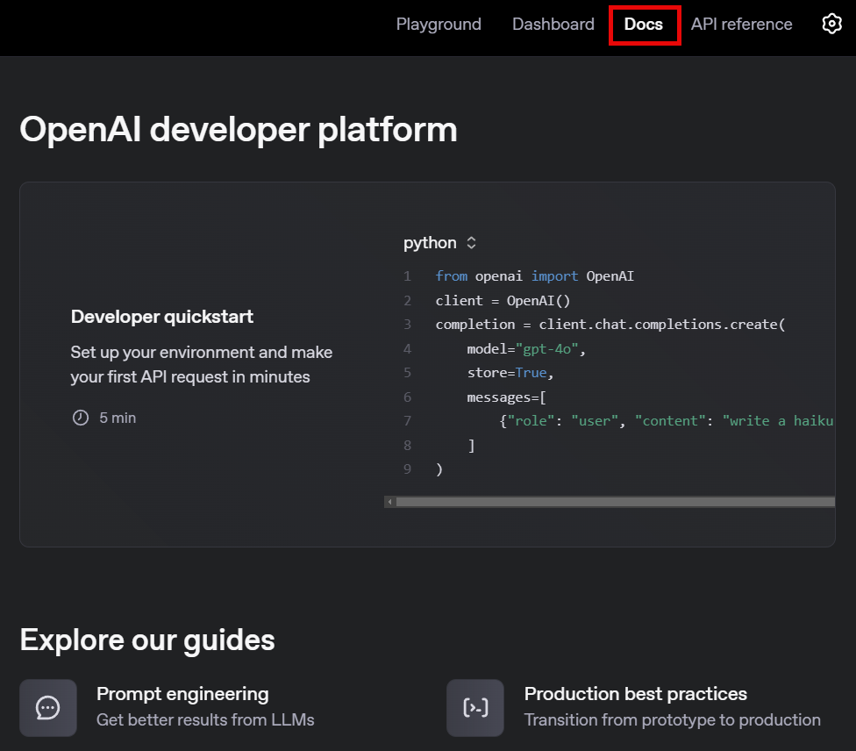
Notes:
https://platform.openai.com/docs/overview

Slide 5
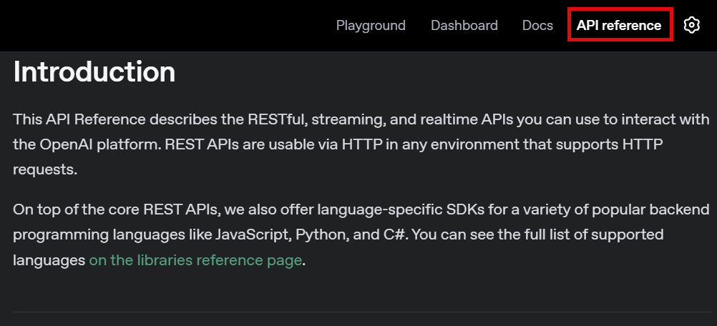
Notes:
https://platform.openai.com/docs/api-reference/introduction

Slide 6
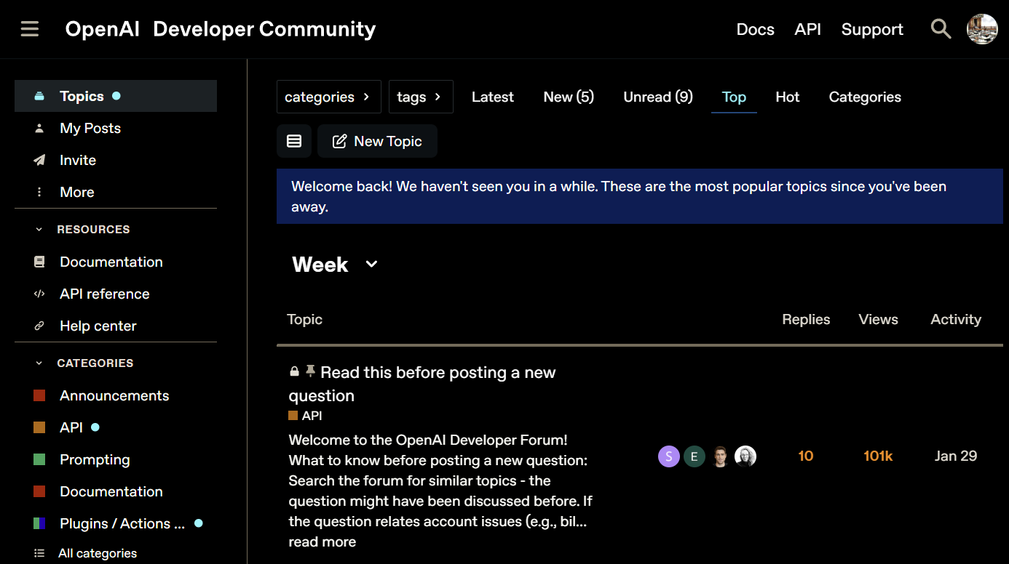
Notes:
https://community.openai.com/

Slide 7
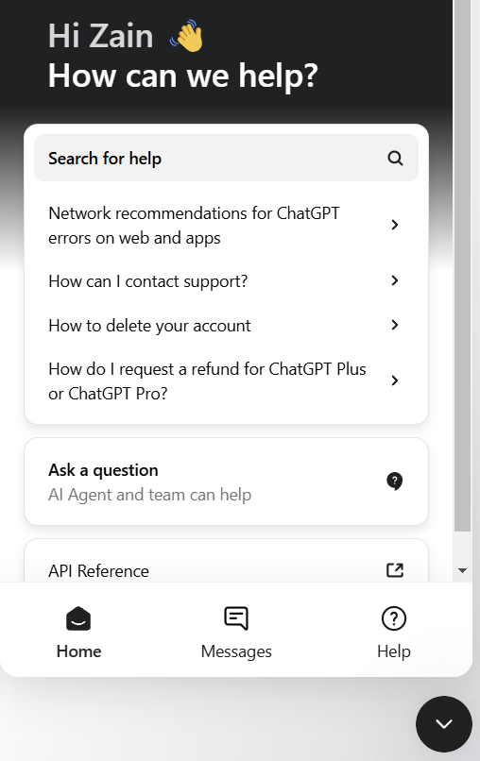
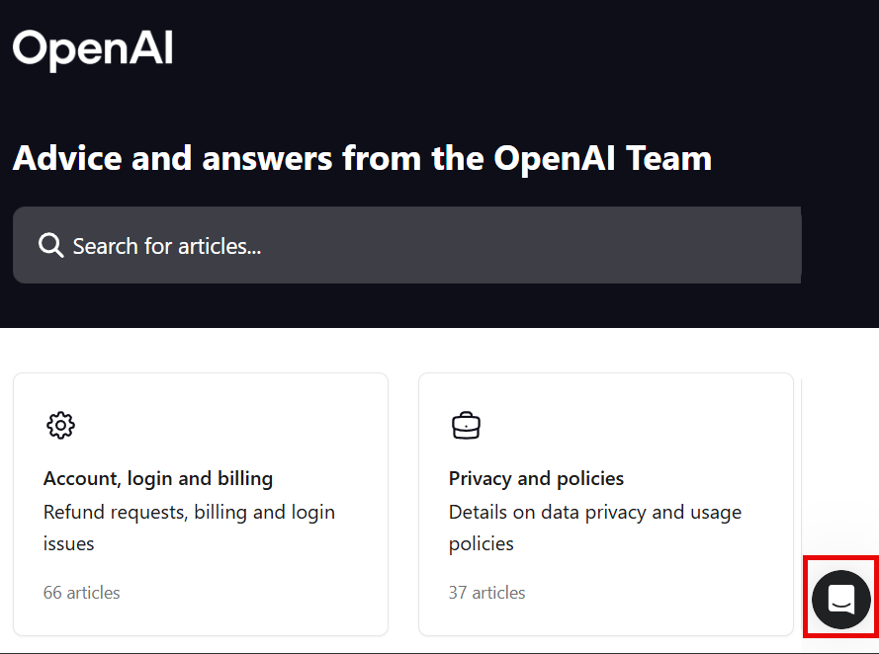
Notes:
https://help.openai.com/en/articles/6614161-how-can-i-contact-support

Slide 8
API Documentation

Slide 9
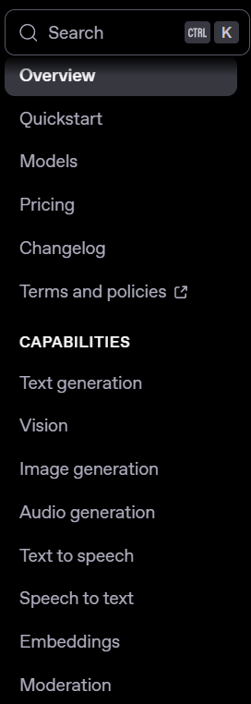
Notes:
https://platform.openai.com/docs/overview

Slide 10
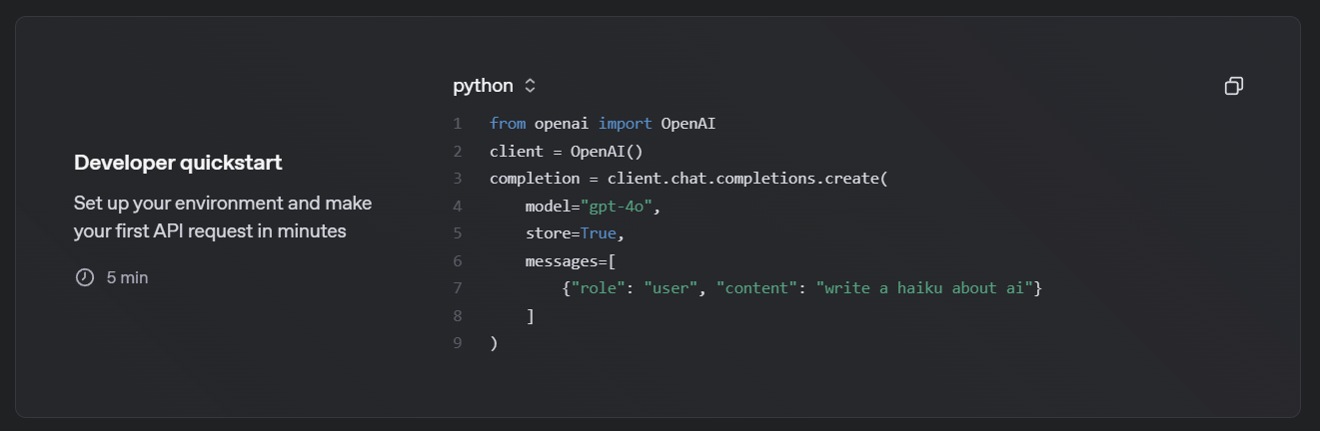

Slide 11
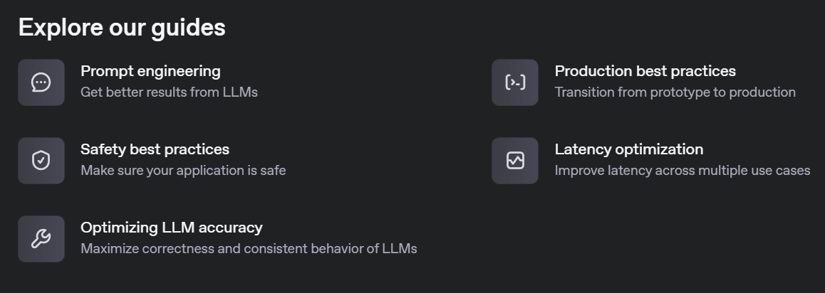

Slide 12
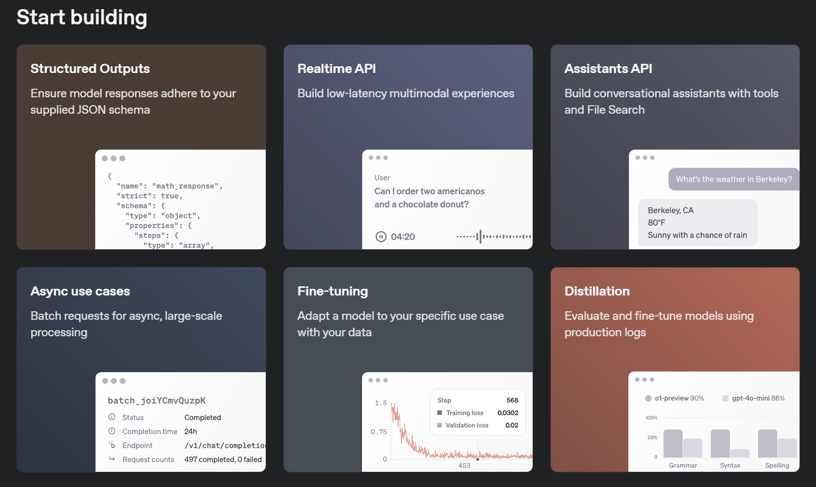

Slide 13
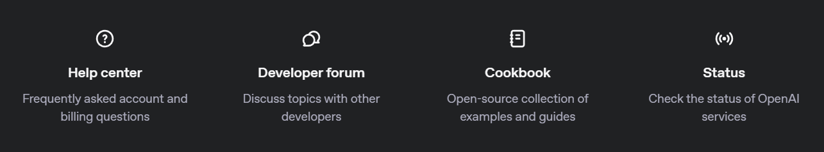

Slide 14
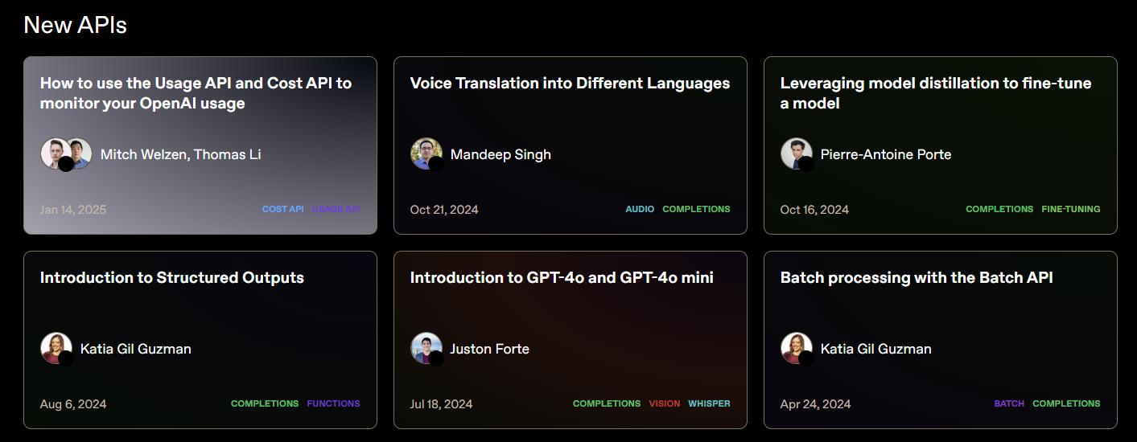
Notes:
https://cookbook.openai.com/

Slide 15
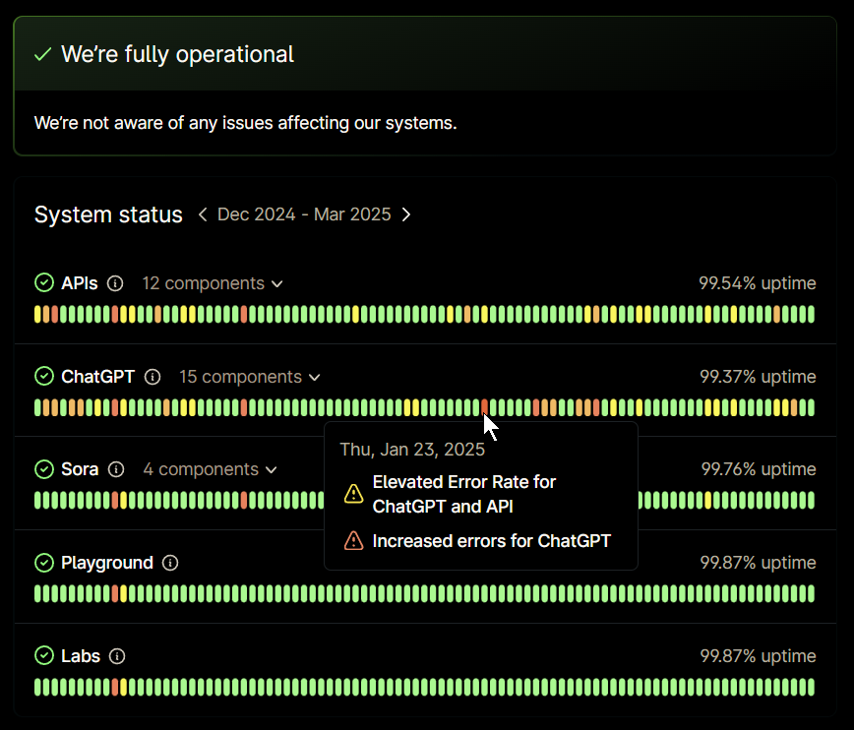
Notes:
https://status.openai.com/

Slide 16
DEMO: API Documentation

Slide 17




Notes:
https://www.youtube.com/channel/UC35ZpwldGw7ZJ5R-2sLijzw

Slide 18
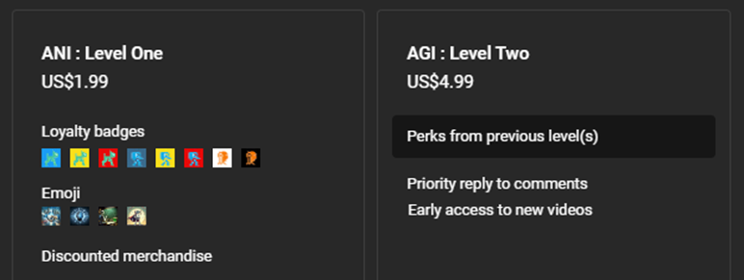

Notes:
https://www.youtube.com/@reallyeasyai/join

Slide 19

https://shop.reallyeasy.ai
Notes:
https://shop.reallyeasy.ai

Slide 20

https://www.youtube.com/@ainewsfresh
Notes:
https://www.youtube.com/@ainewsfresh

Slide 21

https://www.youtube.com/@aipaperspodcastdaily
Notes:
https://www.youtube.com/@aipaperspodcastdaily

Slide 22
Creating a Project

Slide 23
Organization
Project 1
Project 2
Project 3

Slide 24
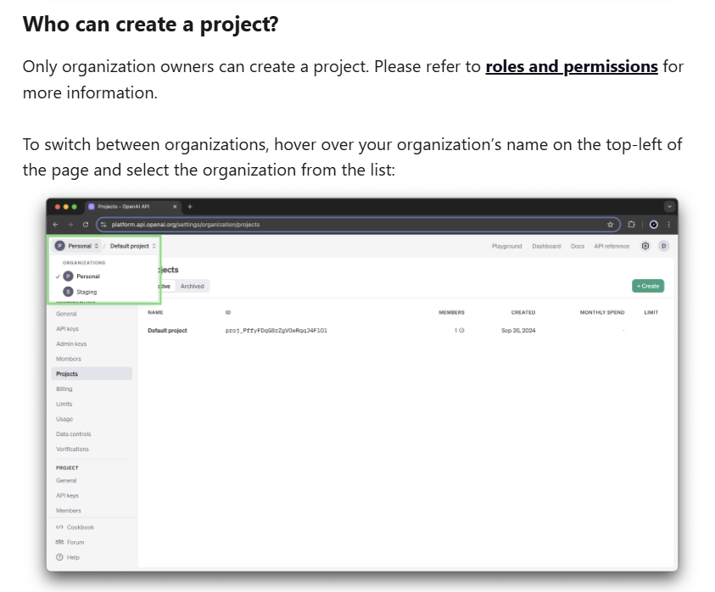
Notes:
https://help.openai.com/en/articles/9186755-managing-projects-in-the-api-platform

Slide 25
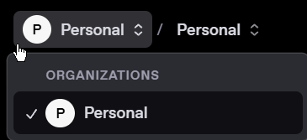
Organizations

Slide 26
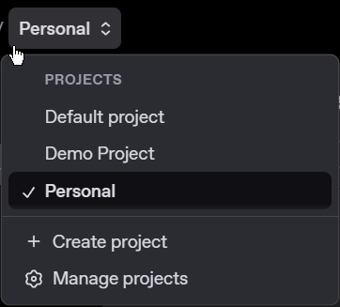
Projects

Slide 27
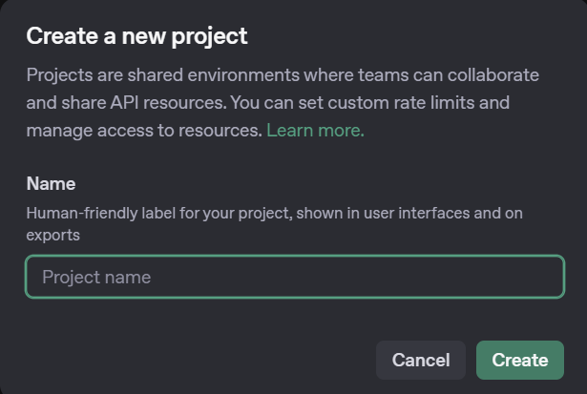
Creating Projects

Slide 28
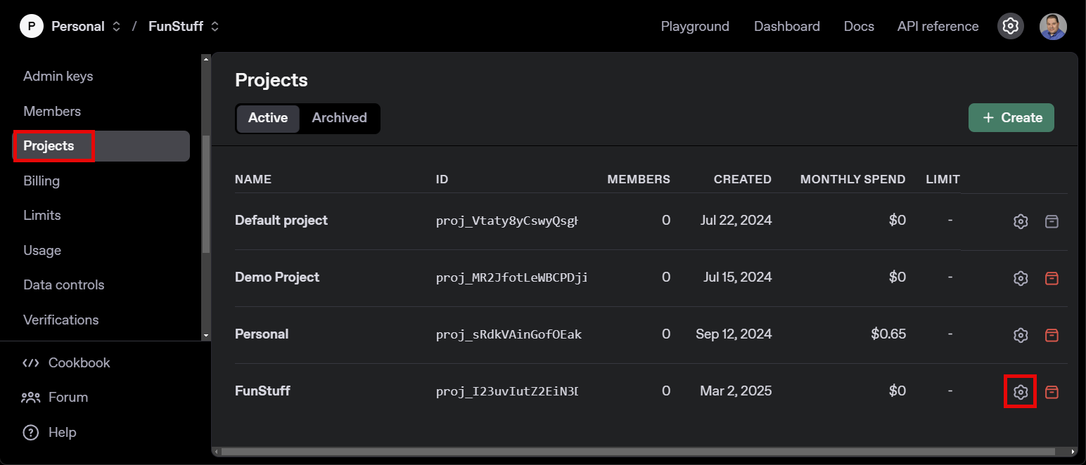
Managing Projects
Notes:
https://platform.openai.com/settings/organization/projects

Slide 29
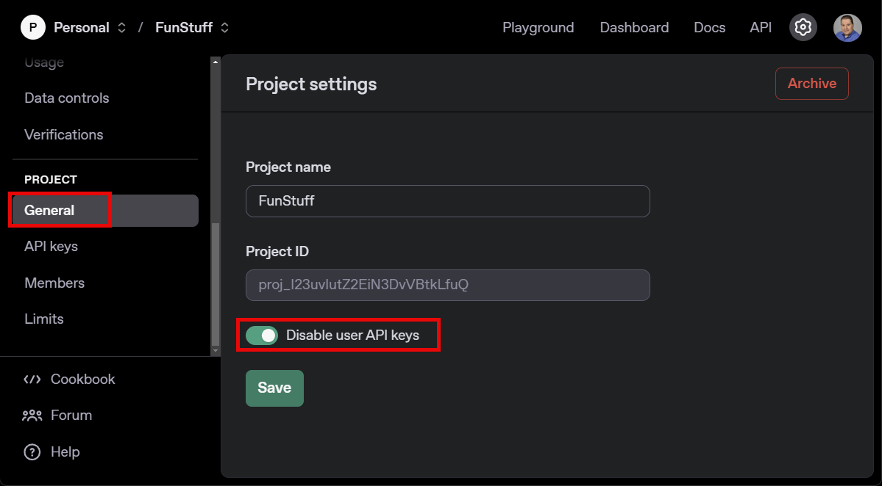
Project Settings – Disable User API Keys

Slide 30
DEMO: Creating a Project
Notes:
Create a project called: OpenAI_API_2025

Slide 31
Adding Members

Slide 32
Organization
👨‍💼👨‍💼👨‍💼
Project 1
Project 2
Project 3
👨🏻‍💼👨🏻‍💼👨🏻‍💼
👨🏽‍💼👨🏽‍💼👨🏽‍💼
👩‍💼👩‍💼👩‍💼

Slide 33
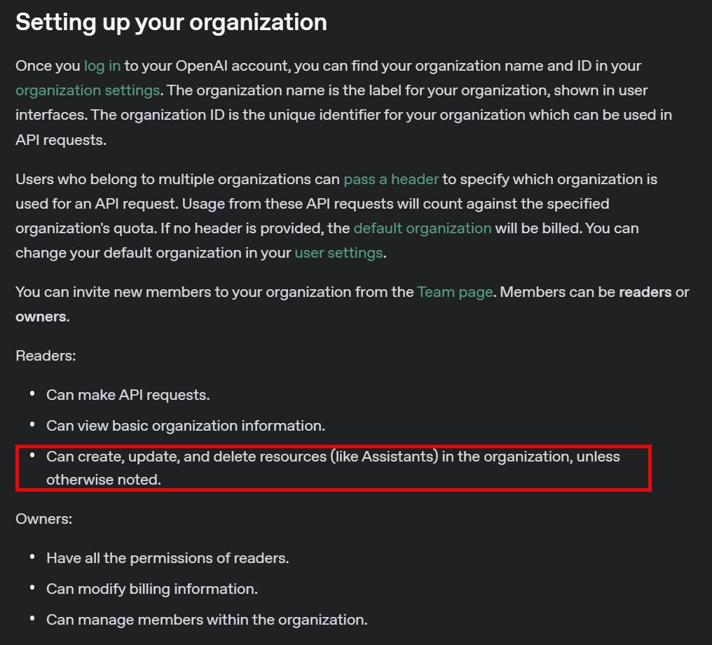
Notes:
https://platform.openai.com/docs/guides/production-best-practices#setting-up-your-organization

Slide 34
Role | Scope | Description
Owner | Organization | Can create/view all projects, all users, all API keys. Has the ability to monitor across all projects within the organization with the Projects page. Able to set billing controls. Can grant permissions to view usage information for others in the org. Can archive projects.
Reader | Organization | Can perform inference, use resources, and create keys. Can be added to projects. Cannot create projects and manage users.
Owner | Project | Can add other users to the project and rename the project, as well as all the abilities of a Member. Can archive the project.
Member | Project | Can perform inference, use resources, and create keys at the project level.
Notes:
https://help.openai.com/en/articles/9186755-managing-projects-in-the-api-platform

Slide 35
Getting an API Key

Slide 36
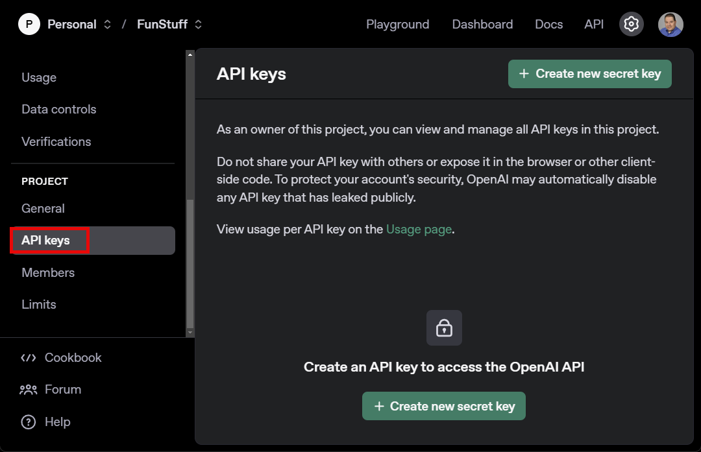
Creating API Keys
Notes:
https://platform.openai.com/settings/organization/api-keys

Slide 37
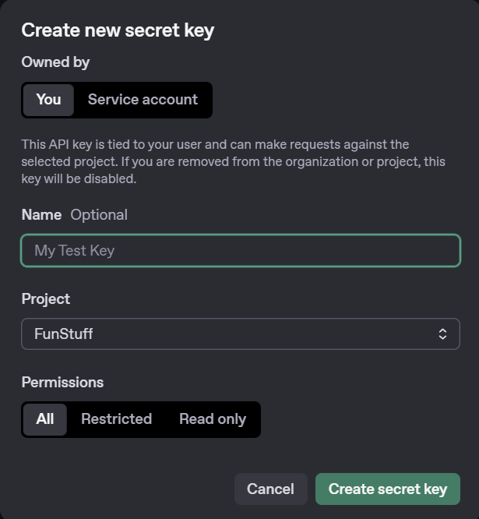
Setting Up an API Key

Slide 38
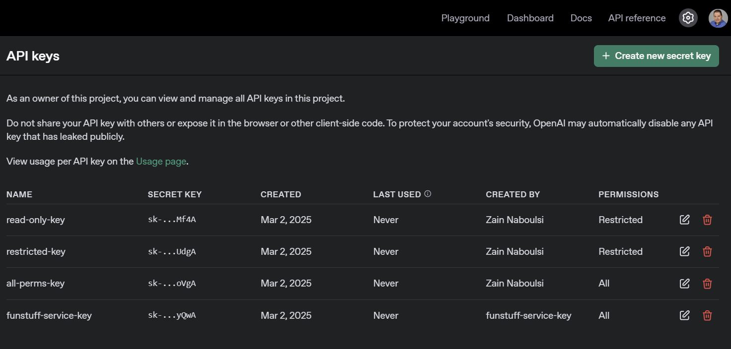

Slide 39
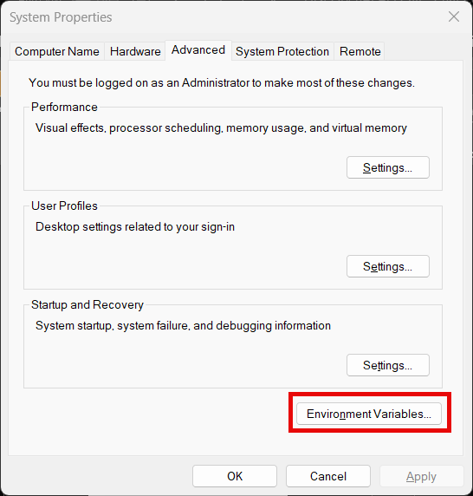
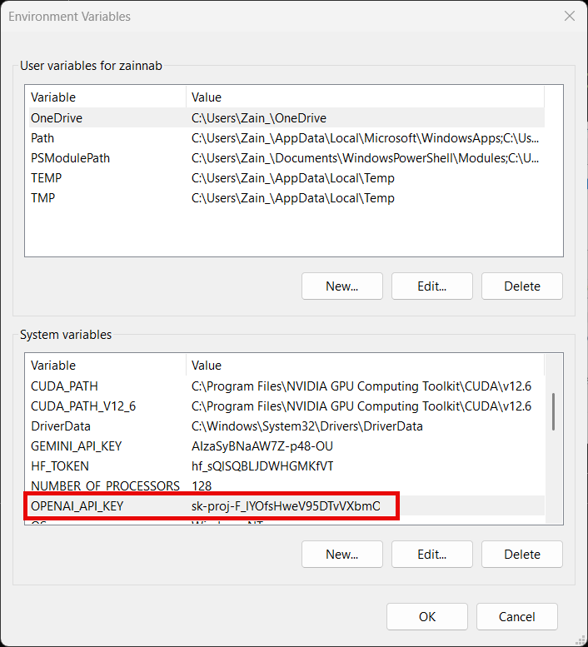

Environment Variable: OPENAI_API_KEY
Notes:
OPENAI_API_KEY

Slide 40
DEMO: Setting Up an API Key
Notes:
Create a key called: OpenAI_API_2025_Key

Slide 41
Preparing to Code

Slide 42
Notes:
https://www.youtube.com/watch?v=50TM9pfYv5U

Slide 43
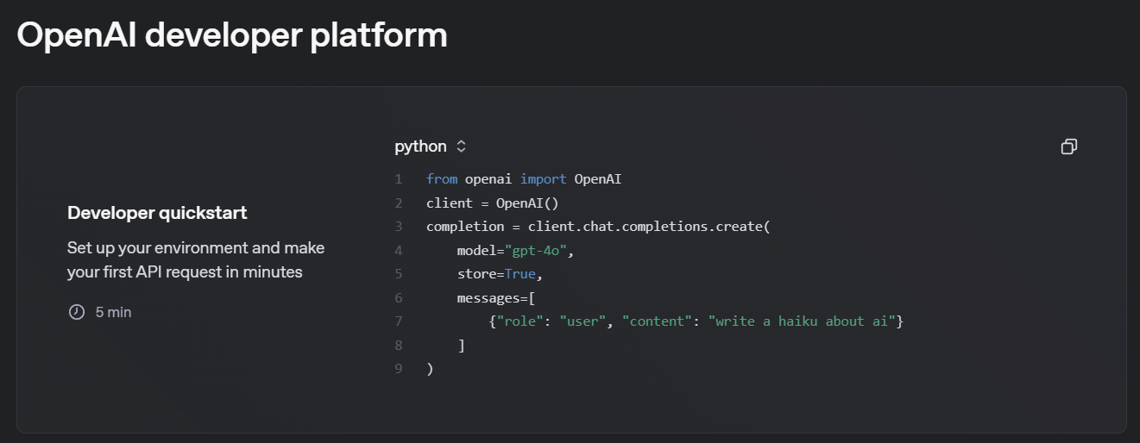
Notes:
https://platform.openai.com/docs/overview

Slide 44
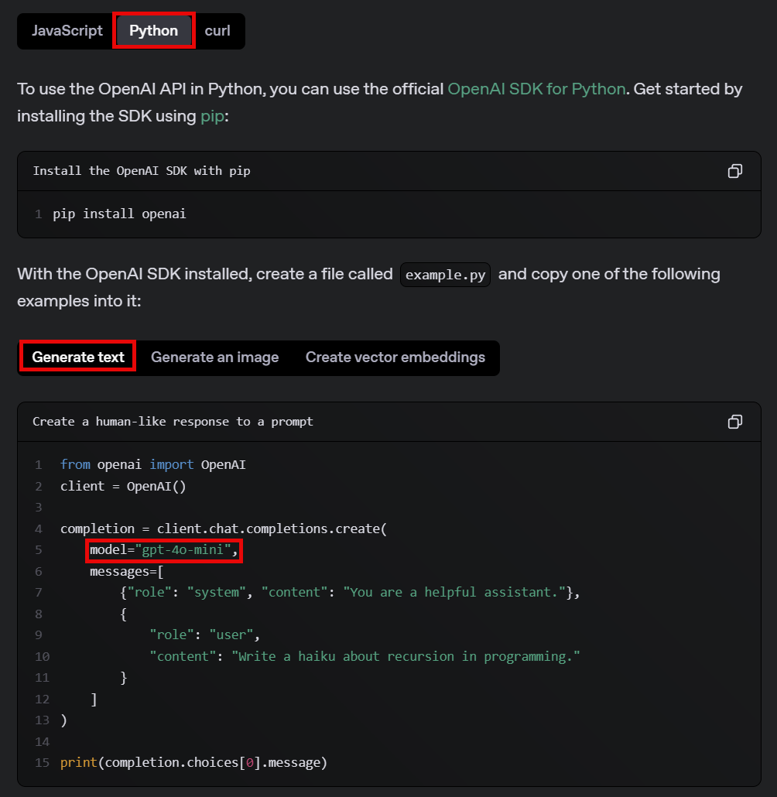
Notes:
https://platform.openai.com/docs/quickstart

Slide 45
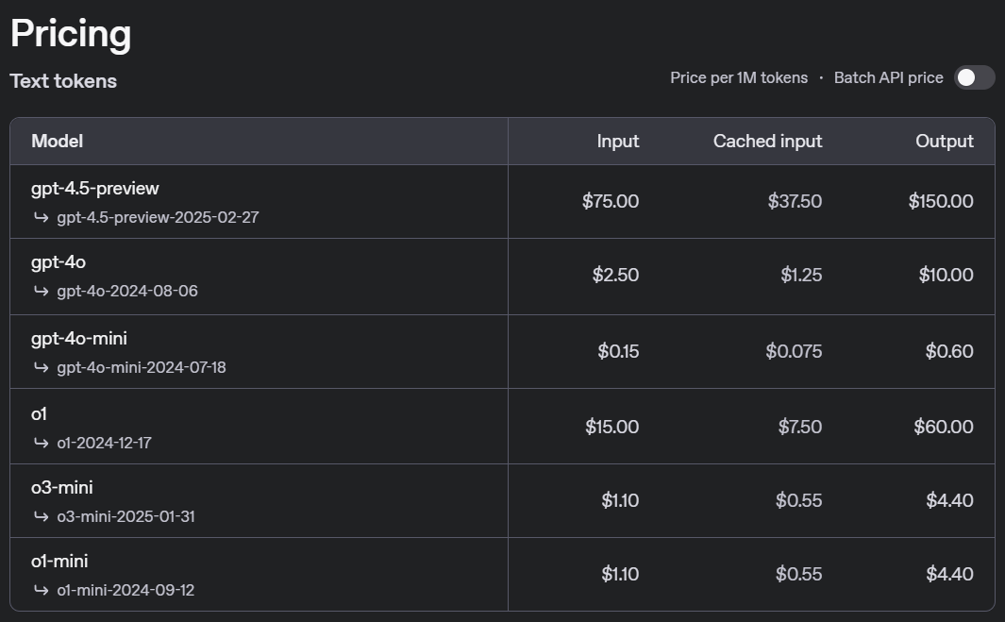


🤯
Notes:
https://platform.openai.com/docs/pricing

Slide 46
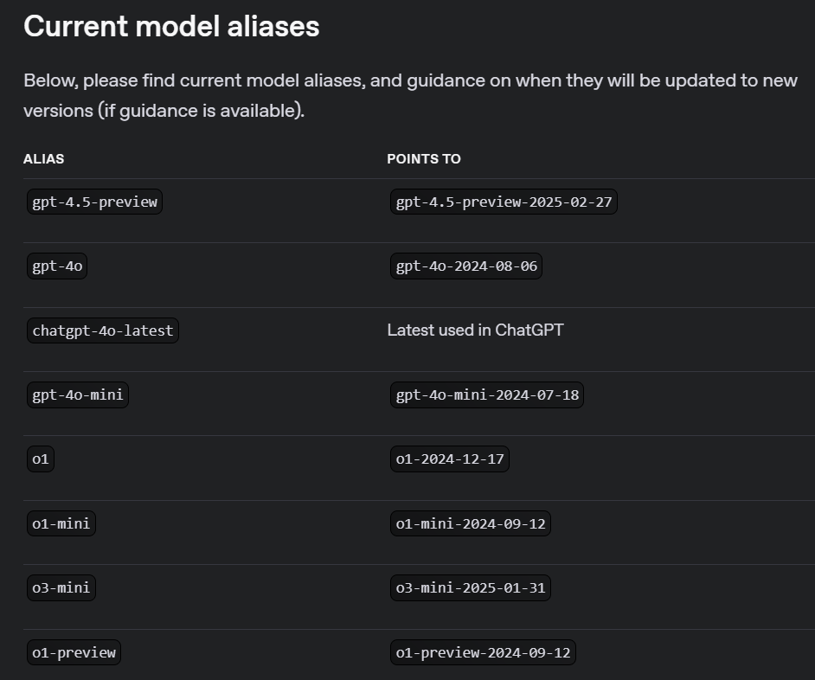
Notes:
https://platform.openai.com/docs/models

Slide 47
DEMO: Your First Chat Completion
Notes:
Run it “as is” then modify the print statement to this for cleaner output: print(completion.choices[0].message.content)

Slide 48
OpenAI API
Your First
Chat
Completion

